Slide 2


Syndemics of Blood-Borne Disease Transmission and Injection Drug Use in Tijuana, Mexico
Claudia Rafful, PhD
Universidad Nacional Autónoma de México, UNAM
Center for Global Mental Health Research
National Institute of Psychiatry
Share your thoughts on this presentation with #IAS2019
I declare no conflicts of interests

Slide 3
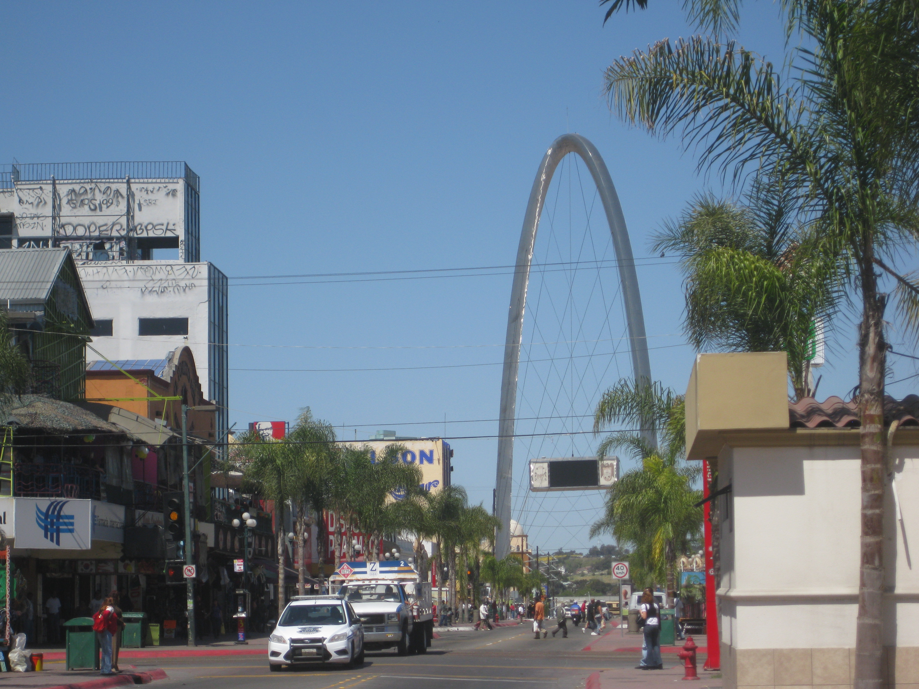
Tijuana, Baja California, Mexico
Approximately 1.6 million people are living in Tijuana
Third most populated Mexican city
Jan-May 2019 19,090 deportations (21%)
8+ million people have crossed in the San Ysidro border in 2018
Getty images
INEGI, 2015
SEGOB, 2019
Bureau of Transportation Statistics, 2019

Slide 4
HIV and HCV in the Tijuana-San Diego region among PWID
HIV prevalence among PWID in San Diego and Tijuana is 4%
HCV prevalence ranges from 27%-51% in San Diego and 96% in Tijuana
Current bidirectional cross-border HIV transmission among risk groups, including PWID
Meacham et al., 2016; Garfein et al., 2013; White
et al., 2007; Mehta et al., 2015; Rafful et al., 2017.

Slide 5
HIV prevelance in Mexico
HIV prevalence in The Americas
Sex workers 7%
MSM 17.3%
PWID 2.5%
Transgender 17.4%
Prisoners 0.7%
← Tijuana
CENSIDA, 2019
Stevens et al, 2006
UNAIDS, 2018

Slide 6

HIV prevalence by risk groups in Tijuana, Baja California
MSM
Women SW
Men PWID
Women PWID
Women SW IDU
Pregnant PWID
Transgender female SW
Pregnant women
Patterson et al. JID 2008; Patterson et al. AIDS 2009; Strathdee et al. JAIDS 2008; Pitpitan et al. JIAS 2015; Salas et al., 2017

Slide 7
Syndemics of blood-borne diseases and IDU in Tijuana
“The border heightens the syndemic of injection-related health and social harms among PWID, and complicates efforts to effectively respond to these harms.”
Syndemic: a set of linked health problems involving two or more afflictions, interacting synergistically, which contribute to excess burden of disease in a population
Rafful et al., 2018
Singer & Clair, 2003

Slide 8
Injection initiation assistance in San Diego-Tijuana
4.6% PWID recently reported providing injection initiation assistance
Higher number of injection-related risk behaviors was associated with recently assisting others with injection initiation (AOR= 1.3; 95% CI= 1.0-1.6)
Prevention of injection-related HIV risk behaviors might also reduce the incidence of injection initiation.
Rafful et al., 2018.

Slide 9
Potential bi-directional disease transmission among established PWID and potential initiate via sexual transmission
HIV-seropositivity among PWID is associated with syphilys
HIV transmission may be spread via injection risk behaviors and unprotected sex
Rafful et al., 2018;
Pines et al., 2015

Slide 10
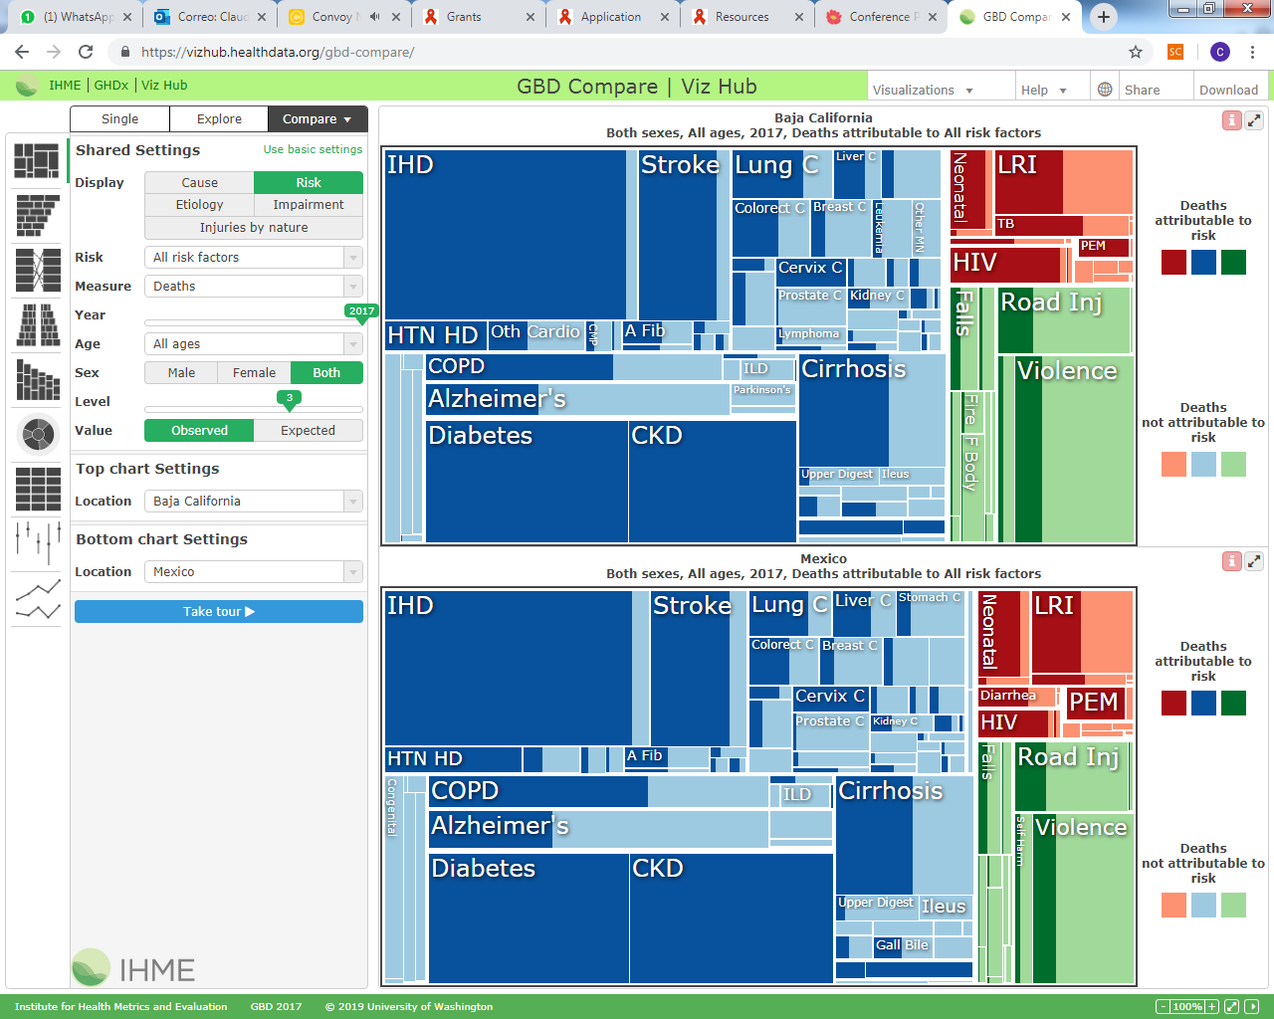
1.55% of total deaths
0.78% of total deaths
IHME, 2017

Slide 11
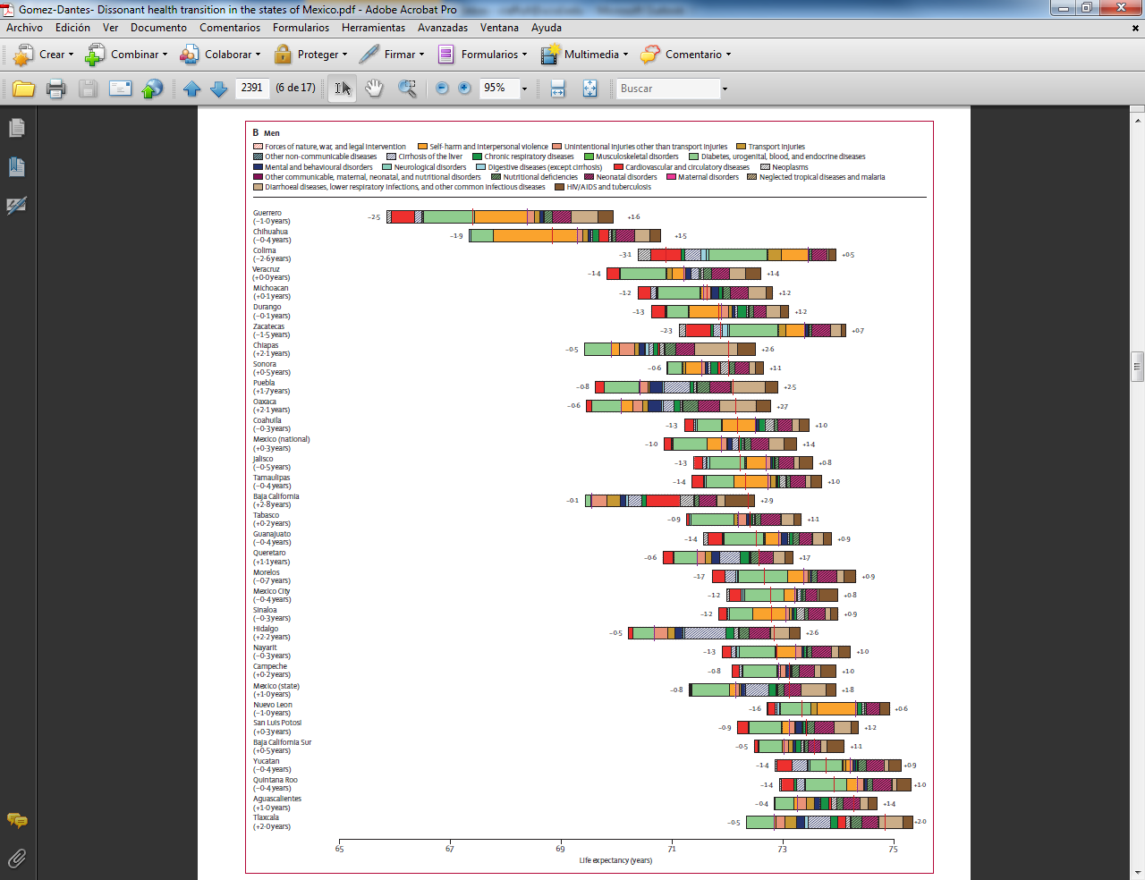
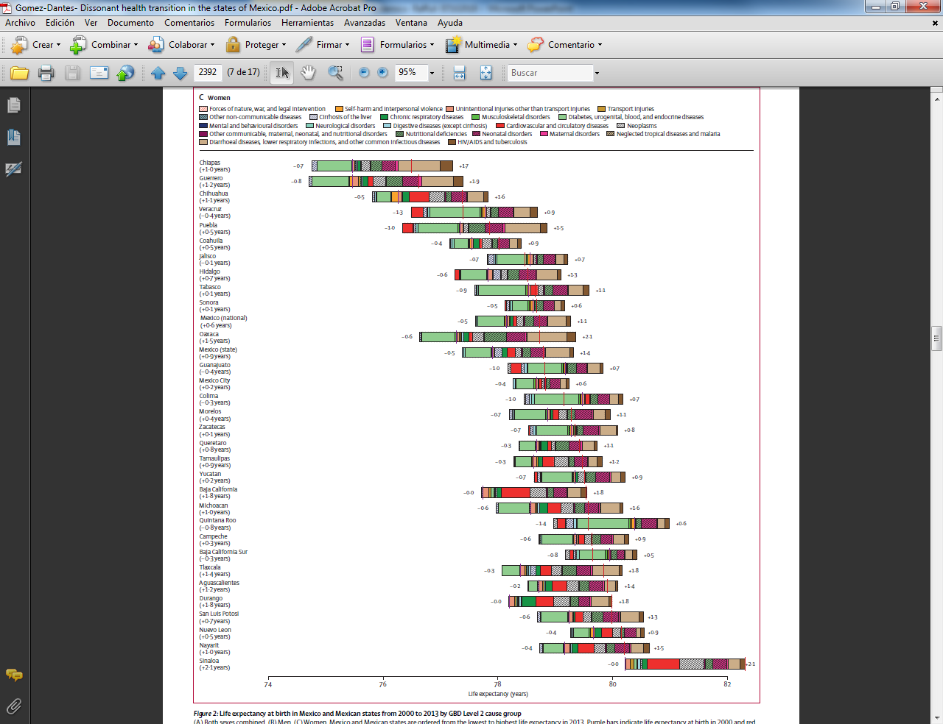
Life expectancy at birth in Mexico by Global Burden of Disease
Men
Women
Gómez-Dantés et al., 2016

Slide 12
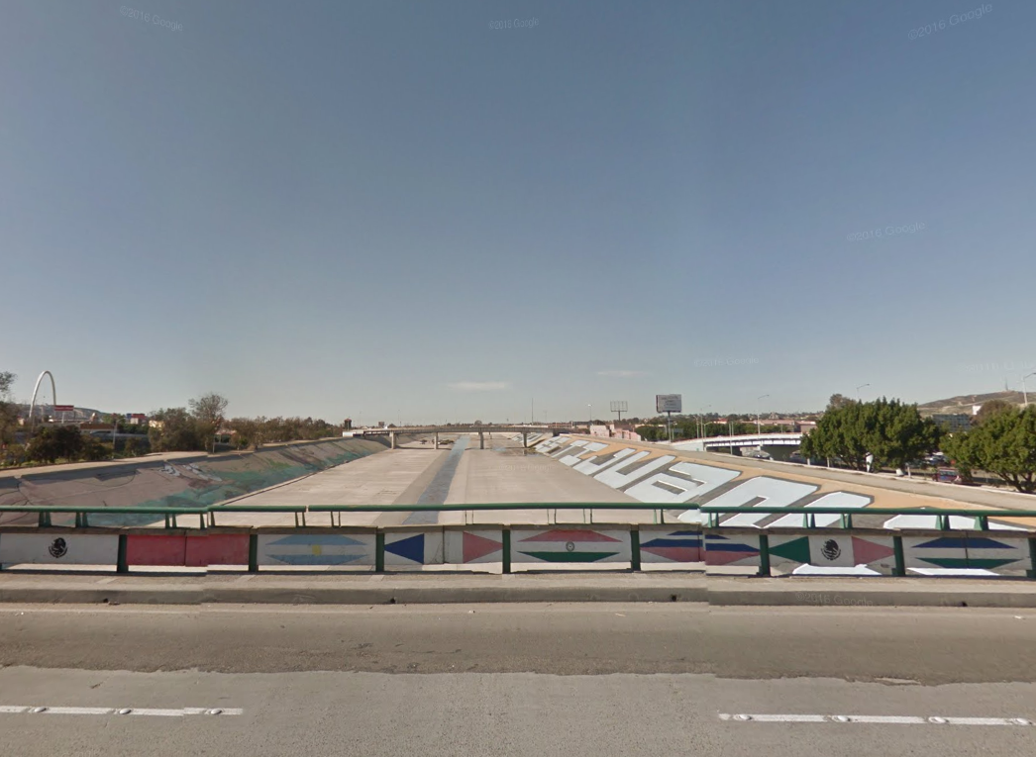
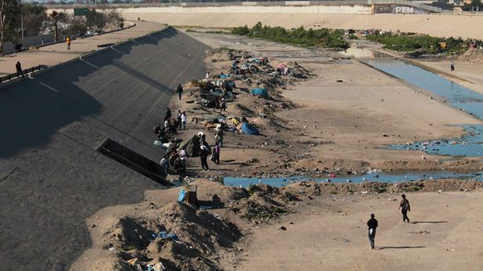
Involuntary drug treatment experiences among PWID
Uncertainty and fear about the degree of violence
Discretionary selection of people taken to drug centers
Absence of medical services
Discrimination and violence at drug centers
Lack of state oversight
Treatment ineffectiveness
Google
Rafful et al., 2019

Slide 13

Drug treatment is not integrated to the health system
Challenges:
GAP for severe dependence
& Comorbidity
Community treatment centers, few with residential care
CAPAS
344 Centros
111 Unidades
CIJ
Slide designed by Medina-Mora 2019

Slide 14
Persons in treatment for injection drug use CIJ
24/32 states
260 heroin,
12 meth,
5 cocaine,
6 prescription drugs,
28 prescription opioids
Chihuahua = 107 M & 21 F
Baja Calif = 60 M & 16 F
Slide designed by Medina-Mora 2019

Slide 15
Drug treatment availability in Mexico
8% of past year PWUD reported having been in treatment
  24.5% centers meet quality standards (7+ sessions, 16 to 35 minutes by a health professional)
20% of PWUD with drug dependence (DSM-IV-TR) reported having received treatment
  48.5% detox
  50.7% residential
  49.6% “annex” (12-step based NGO’s – persons who have overcome addictions)
  23.1% ambulatory services
Increased availability of opioids for pain management- Reform
Slide designed by Medina-Mora 2019

Slide 16

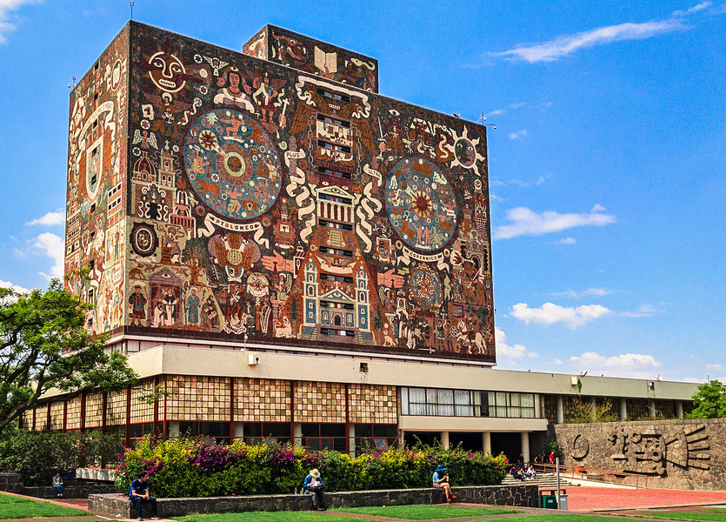
Acknowledgements
El Cuete participants & staff
Fogarty International D43TW008633
CONACyT 209407/313533
El Cuete R37 DA019829
CIHR Postdoctoral Fellowship
María Elena Medina-Mora
Steffanie A. Strathdee
Patricia González-Zúñiga
Ricardo Orozco
María Luisa Zúñiga
Pete Davidson
UNAM
crafful@comunidad.unam.mx

